Slide 1

Answer it!
CS33 PROJECT
Abdelrahman Mustafa El-Feky 19102270
Amr Ibrahim Soliman 19101776
Supervisor : Eng. Suhaila Mohamed

Slide 2

Declaration
I certify that this assignment/report is my own work, based on my personal study and/or research and that I have acknowledged all material and sources used in its preparation, whether they be books, articles, reports, lecture notes, and any other kind of document, electronic or personal communication

Slide 3
1.1 The Client
Our chosen client is Eng. Mark Tharwat , who is a very experienced academic tutor and instructor , with many courses on famous course websites including Coursera and Udemy.

Slide 4
Client Contact Information
Client Name: Mark Tharwat Antonio
Email: ihackprojectsmm@gmail.com
Tel.: +20 100 422 2114
Links:
LinkedIn: https://eg.linkedin.com/in/mark-antonio-b2777310a
Udemy Profile: https://www.udemy.com/user/markantonio2/
Facebook: https://www.facebook.com/manovinrecords

Slide 5
Project overview
The project’s main goal is to help the students in Egypt and the Arab world in their studies by providing them with answers to their questions regarding the topic they choose.

Slide 6
The problem
Not having a personal website where he can post his own content
Not having a proper platform that serves only the MENA region

Slide 7
The Required Features requested
The students will be able to ask their questions and they will receive the response by some professionals in the field.
Providing registration and login on the website.
Preventing the students who are not signed in from viewing the questions and answers.
Allowing for the students that are only logged in to view only 2 answers per month.
Allowing the students to pay online with monthly and yearly options.
Only subscribed students can view as many answers as they like and can post up to 10 questions per month.

Slide 8
Now we turn to the website (code)

Slide 9
Steps to use the website
Navigate to our website.
Log in/Register if he hasn’t and fill all the information needed.
After that his registration has been confirmed he will be directed to the home page in order to log in.
After successfully logging in All the available subjects will be shown in order to view their questions and answers.

Slide 10
Revenue Scheme
This website’s revenue is based on the online payment method so the students have the option to choose between monthly subscription and yearly subscription.

Slide 11
Website Limitations
The only language the website provides is English.
Only the index page has the dark mode feature.
The Page that allows for the students to post their questions still need some improvement.
The payment page still needs some work to ensure that the payment is secure.

Slide 12
Features to come
Adding a full Arabic translation for the website
1
Implementing the dark mode to all pages
2
Improving the question forum page where students post questions
3

Slide 13
Chegg
We can’t talk about this field without mentioning one of the most known and used website in this area. Chegg helps and supports student all around the world in their educational studies by giving them answers to their questions, physical textbook rental…etc.
Chegg began in 2005 in the United States and in 2020 the number of the people who are subscribed in Chegg has surpassed 3 million subscribers.
Chegg chose a strategy called horizontal growth so that in order to dominate the market they focus on strong acquisition of other competitors.

Slide 14
Pros | cons
It is a user-friendly website, easy to use and easy to find anything the user is looking for. The users will receive a timely answer for their question regarding any subject. Unlike other websites Chegg contains textbook rentals and internships services. There is a website called Chegg Life which is parent website for Chegg and it concentrate on money, wellness and health for students. | Chegg website should improve some aspects by adding a better color palette. Chegg is only in English which might deter other students whose English is not their language. Many Universities dislike it due to its regularly reported academic dishonesty. If the user is not subscribed then the user won’t be able to enjoy the website’s features and services. Chegg allows anyone registered on the website to answer questions asked and that elevates the probability that the answer is wrong. The subscription on Chegg is costly.

Slide 15
CourseHero
Founded in 2006, based in the United States and also a very known website called CourseHero. Originally, founded by a student to share lectures, notes, exams…etc. But now it is an online platform for online learning for students and providing some simple homework, essays, textbooks and other stuff depending on the subject chosen.

Slide 16
Pros | Cons
The website has a great color palette which makes it easier on the eye and also it doesn’t have any parent websites which help them be more focused on their main objectives. CourseHero provides full textbook solution. Unlike other websites CourseHero doesn’t only provides question and answers it also provides some courses and video lectures. Unlike Chegg the only persons who have the authority to answer the questions asked are the tutors. | The website has a bad layout. The only language available on the website is English. If the student is not subscribed he can’t enjoy any feature from the website and not even a trial period. The question takes a long time to be answered due to the small number of users on this website.

Slide 17
Slader (Now Quizlet)
Founded in 2005 in the United States, it is an educational website which provides textbook answers, explanations and study sets/problems. What makes it unique is that it has a big database of textbook solution provided by professionals.

Slide 18
Pros | Cons
Unlike other websites it has a dark mode. Quizlet is considered on top of the list due to its great layout, color palette, and it is very user-friendly website, and the flash cards interactive questions and answers. It provides a 7-day trial unlike other websites. The textbook solutions and the flash cards are the main features that makes this website very unique. | The website is considered more of a gaming website rather than a student-aid. The teachers and tutors on the platform are the only people that are allowed to solve the textbook answers. Anyone can add flash cards to the website which might make the website harmeful.

Slide 19
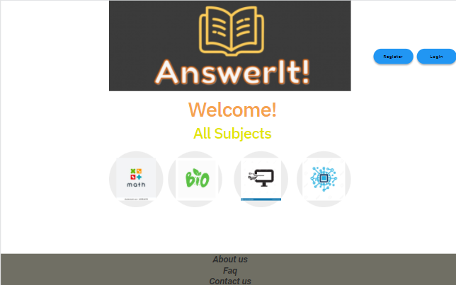
Website Prototype

Slide 20
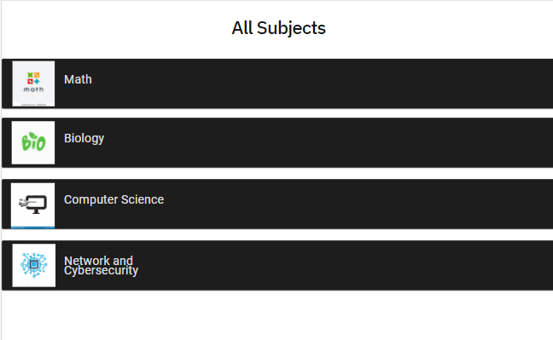

Slide 21
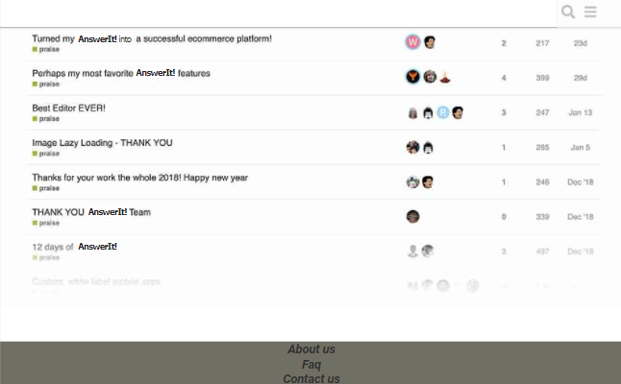

Slide 22
Thank you!

